Slide 1
Hack the Box Supermarket

Slide 2
Contents
Introduction | Team details and introduction
Hack the Box and Types | What is hack the box and other options
Challenge details | Details of the challenge
Status | How far we solved the challenge
Reference | List website, blogs we referred for doing this project

Slide 3
Team Members
Mitul Raj Samba | 11695051
Bindu Priya Pannala | 11609880
Kaushik Apoori | 11705023
Malvika Ralla | 11607929

Slide 4
01
Introduction
Hack the box- Supermarket

Slide 5
Today, we'll explore how this innovative platform can transform your approach to learning and applying hacking skills in a controlled, legal environment. Get ready to discover how you can boost your cybersecurity prowess and connect with a global community of like-minded enthusiasts and profession

Slide 6
Hack the box
Hack The Box provides a fully immersive, interactive platform where both novices and experienced cybersecurity professionals can hone their skills.
The environment includes real-world scenarios that challenge users to apply their knowledge in penetration testing, security research, and problem-solving in a way that textbooks and traditional learning do not.
HTB features a diverse set of challenges and machines that cover various aspects of cybersecurity, including but not limited to web security, cryptography, forensics, and binary exploitation

Slide 7
Like HTB
TryHackMe
CTFtime
VulnHub
OverTheWire
Root Me
PentesterLab
Here are some of the other platform which is similar to HTB, which we can use to improve our hacking skills in different environments.

Slide 8
Challenge Details
Challenge Name: Supermarket
Challenge description: My supermarket list is too big and I only have $50. Can you help me get the Discount code?
Level: Medium
About the challenge: It’s a mobile application challenge where we need to find the Discount code for the user which is the flag we need to submit for completing the challenge.
It falls under Mobile category

Slide 9
Procedure
For doing this challenge we can do the following things
Decompiling the APK
Dynamic Analysis
Search Through the App

Slide 10
Decompiling the file
We used the below methods to get to the code.
Using jadx:
Download jadx from https://github.com/skylot/jadx.
Install and open jadx.
Drag and drop your APK file into jadx's window.
Browse the source code to locate logic related to discount code generation or retrieval.
Using dex2jar and JD-GUI:
Download dex2jar from https://github.com/pxb1988/dex2jar.
Download JD-GUI from http://java-decompiler.github.io/.
Convert the .dex file inside the APK to a .jar using dex2jar.
Open the .jar file with JD-GUI to view the decompiled source code.
Search for strings, methods, or classes that handle discount codes.

Slide 11
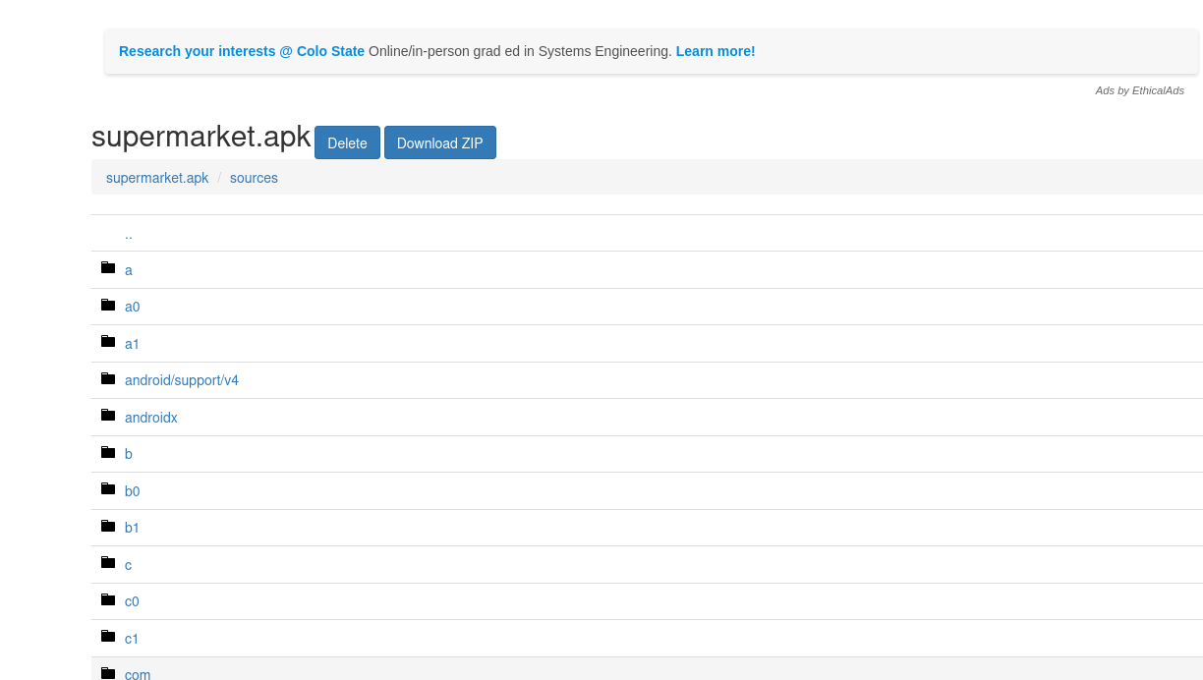

Slide 12
Dynamic Analysis
Using an Android Emulator:
Set up an Android emulator using Android Studio.
Install the APK on the emulator.
Use tools like Wireshark to monitor network traffic or Android's built-in debugging tools to observe runtime operations.
Look for API calls or other operations that might involve the discount code.

Slide 13
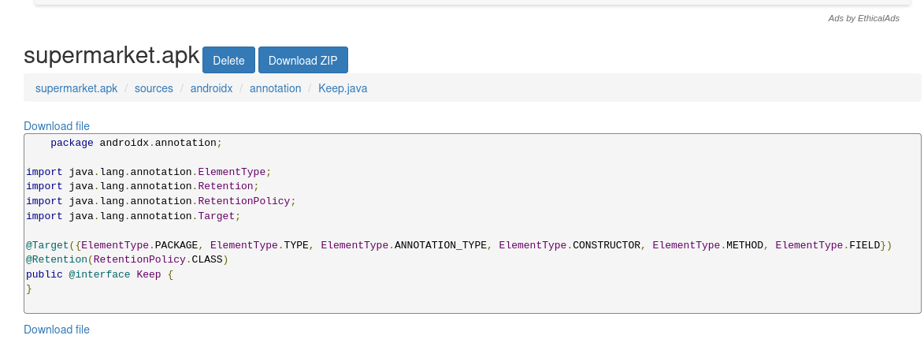

Slide 14
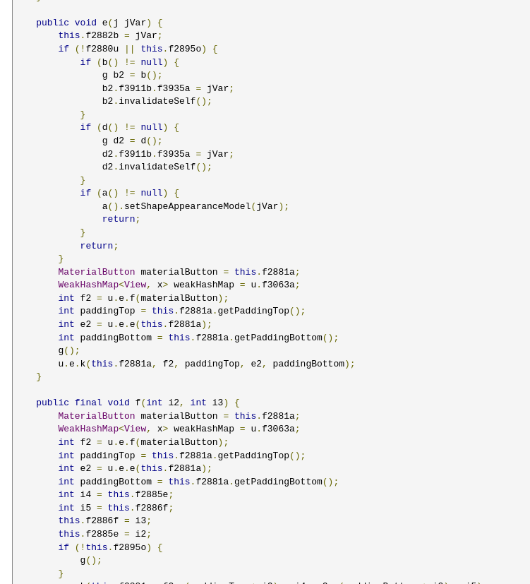
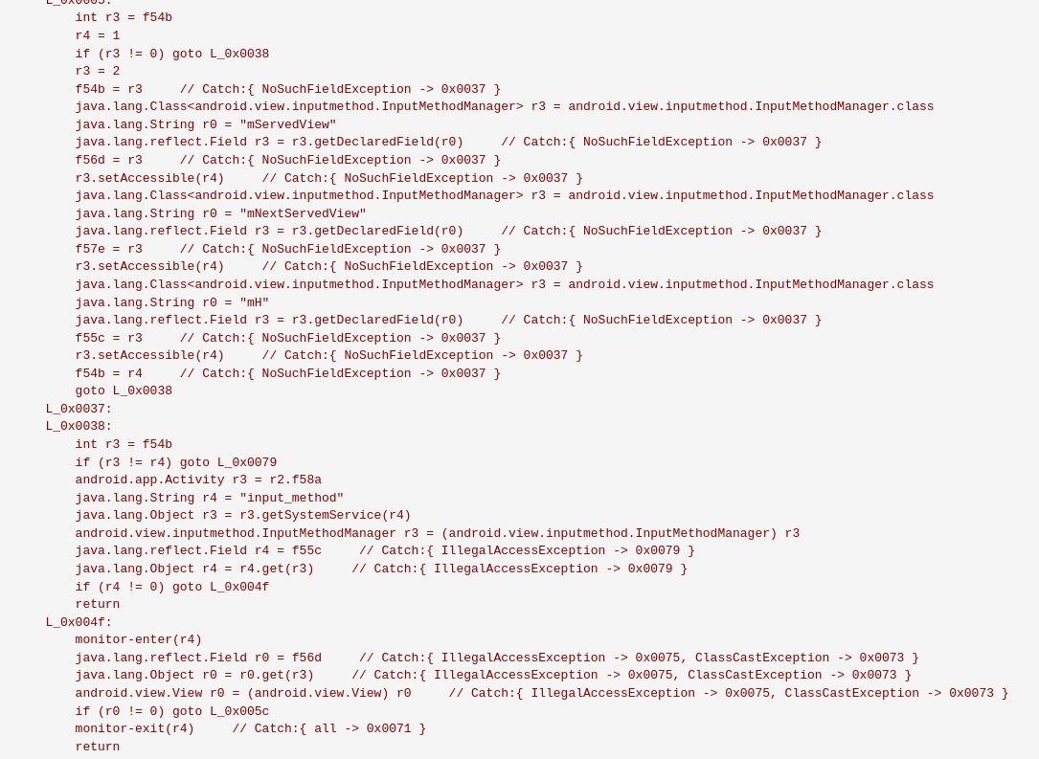

Slide 15
Search Through the App
We can install the app on an Android device and explore its features to see if there are obvious ways to retrieve or generate the discount code through user interaction.
Transfer the APK to your Android device and install it (make sure to enable installations from unknown sources).
Use the app and explore its features to see if the discount code can be obtained through normal usage.

Slide 16
Conclusion
We couldn’t complete the challenge as we don’t have enough knowledge required for decoding the java byte code.
We tried different approaches as mentioned above.
We learned following things when we are trying to extract and decipher a discount code from a decompiled Android application package (APK).

Slide 17

References
https://www.decompiler.com/jar/41fd2fa9116e49b7b45f57bb52164e0c/supermarket.apk
https://java-decompiler.github.io/
https://github.com/skylot/jadx
https://github.com/pxb1988/dex2jar

